Slide 1
Hr Analysis Dashboard
PRESENTED BY GROUP 4

Slide 2

OUR TEAM
Apoorva Upadhyay
devata paras Jadhav
Swati birudev karanwar
Deeksha patil
Mrs. k. jeevanandhini
Rushikesh nitin karne
Sanket Rameshwar shinde

Slide 3
Agenda
Project Details
KPI
Charts
Dashboards
Key Insights
Recommendations
Conclusion

Slide 4
Project Details
HR Analytics Project – A Data-driven Approach To Workforce Optimization
The HR Analytics Is The Process Of Gathering, Collecting , Analyzing And Interpreting Data Related To Human Resources To Make Informed Decisions That Can Improve Business Performance.
By Leveraging Data, HR Teams Can Identify Trends , Predict Future Outcomes , And Optimize Workforce Strategies.

Slide 5
KPI
Total Employee : 50,000
Average Age : 39
Avg Monthly Income : 26,016
Avg Hourly Rate : 115.43
Attrition rate : 50.21%
Avg % hike : 25%
Avg year at company : 11
Avg Performance rating : 2.5

Slide 6
Chart 1 DEPARTMENT VS AVG ATTRITION RATE
R&D Department has highest Attrition rate of 51.21%
Hardware Department with lowest attrition rate of 49.44%

Slide 7
CHART 2 HOURLY RATE
Average Hourly Rate for Male Research Scientist is Rs.114.45

Slide 8
CHART 3 Department vs monthly income vs attrition rate
Average Monthly Income of sales Department is 26.12K, so Attrition is also less.
Average Monthly Income of R&D Department is 25.80K, so Attrition Rate is also high with rate of 51.21%

Slide 9
CHART 4 Department vs average working years
Working Years of all Department is almost 20 years.
Among all Departments Software Department has highest Average Working year of 20.62 and R&D has Average working year of 20.30

Slide 10
chart 5 Job role vs work life balance
Almost all Department has the Average Work life Balance of 2.
Health Care Department has good Wook Life Balance.
Sales Executive has Poor work life balance of 2.47.

Slide 11
Chart 6 Year since last promotion vs attrition rate
Employees who got Promotion between 21 to 25 years has highest Attrition rate of 51.23%

Slide 12
Chart 7 AGE GROUP vs attrition rate
Employee group with age above 56 has highest Attrition.
Employees age ranging between 36 to 45 has the lowest Attrition of 49.34%.

Slide 13
Chart 8 Travel Distance vs attrition rate
Employees travelling from Near by Distance (1 to 10 km ) has highest Attrition rate of 50.84%.

Slide 14
Chart 9 Gender vs attrition rate
Almost both gender has Equal Attrition rate, Compare to male Female Employees record the highest Attrition Rate.

Slide 15
Difficulties
Implementing HR analytics comes with challenges such as curating data from various sources, lack of data analytics skills among HR professionals, privacy and compliance concerns, insufficient IT resources, data variety from disparate HR tools, and potential employee resistance to relying on technology for HR functions.
Performance management Traditional annual reviews may not be enough to meet the needs of modern workplaces. This can lead to disengagement and a lack of alignment between individual and organizational goals.

Slide 16
Screenshots of Dashboards

Slide 17
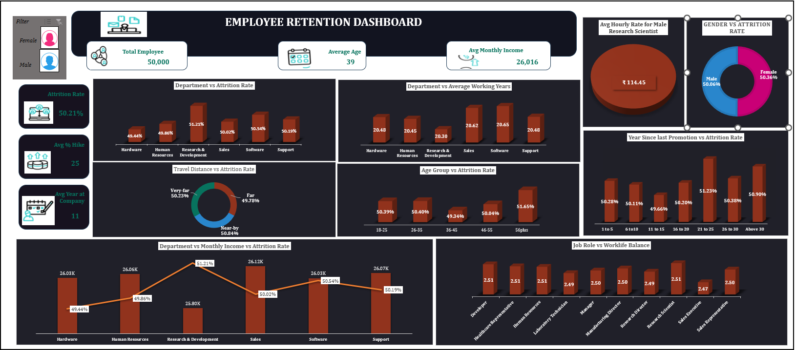
Excel Dashboard

Slide 18
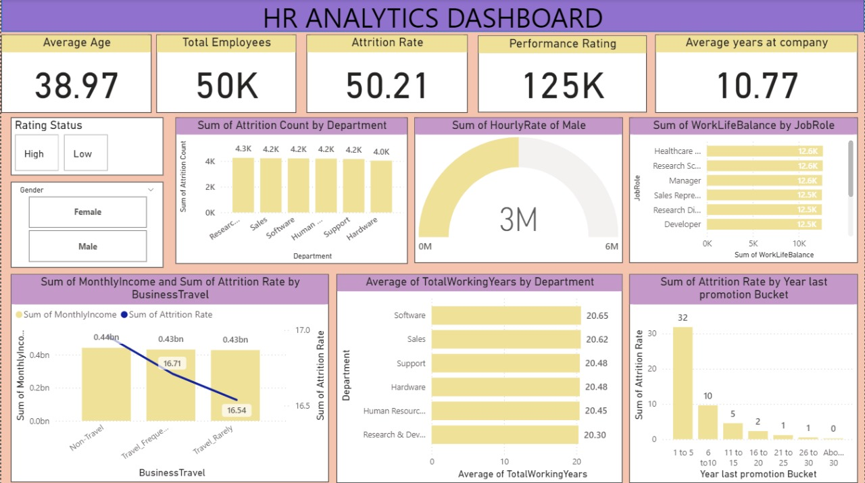
Power bi Dashboard

Slide 19
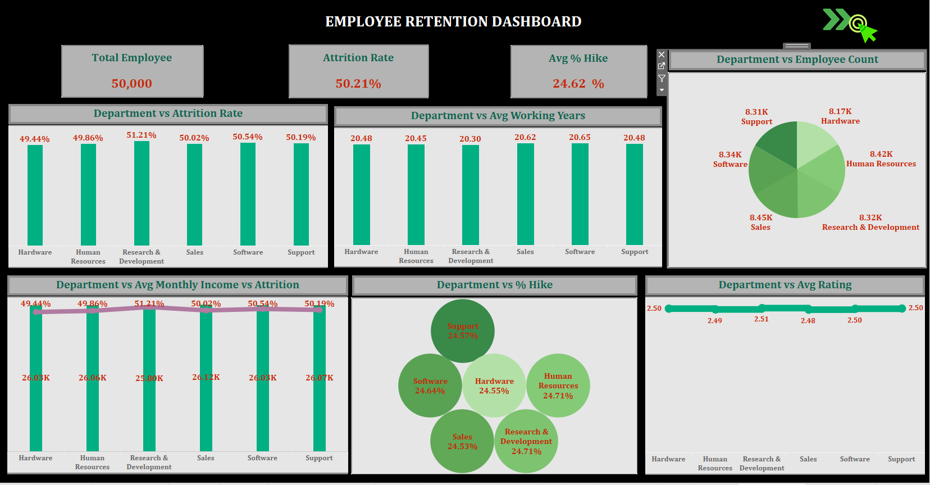
Tableau Dashboard

Slide 20
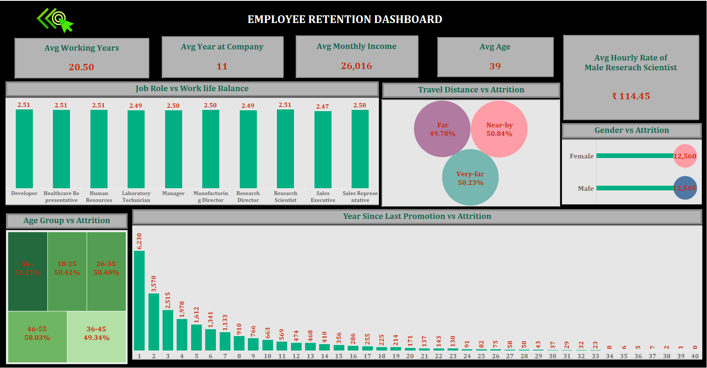
Tableau Dashboard

Slide 21
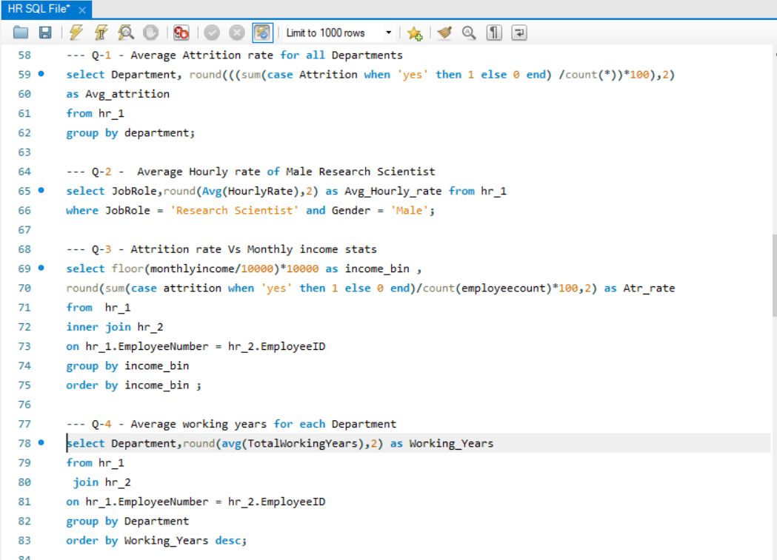
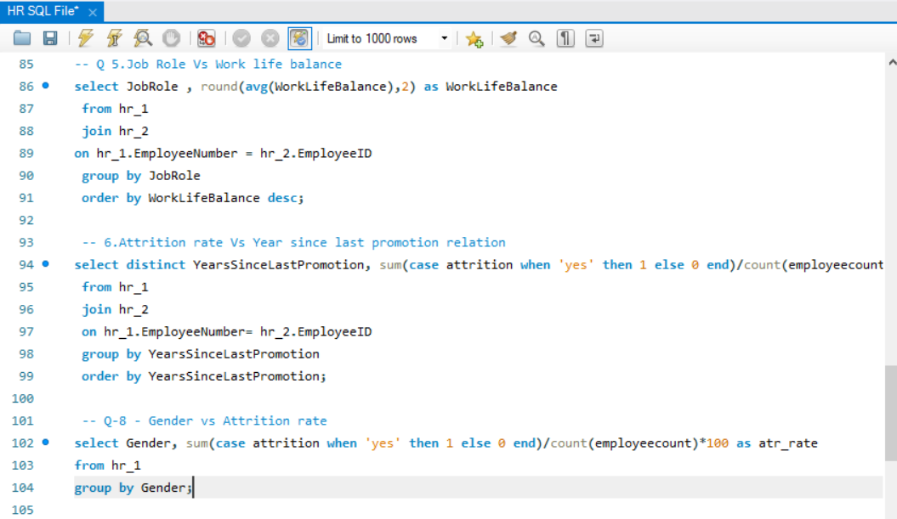
SQL Queries

Slide 22
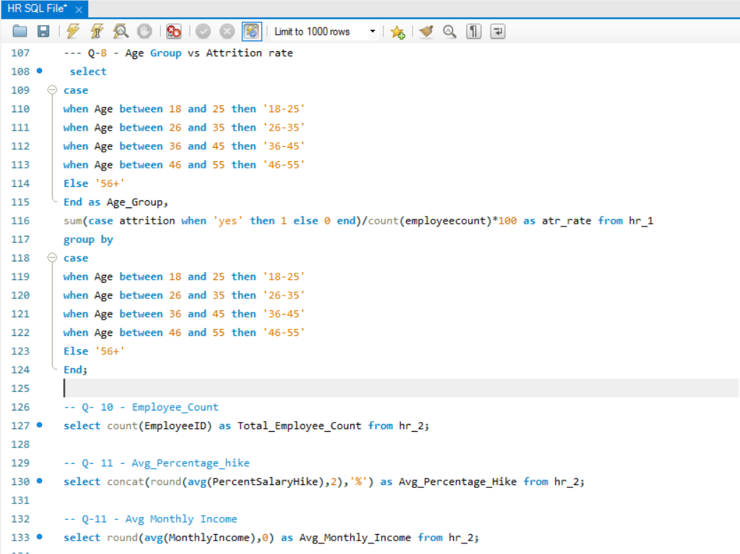
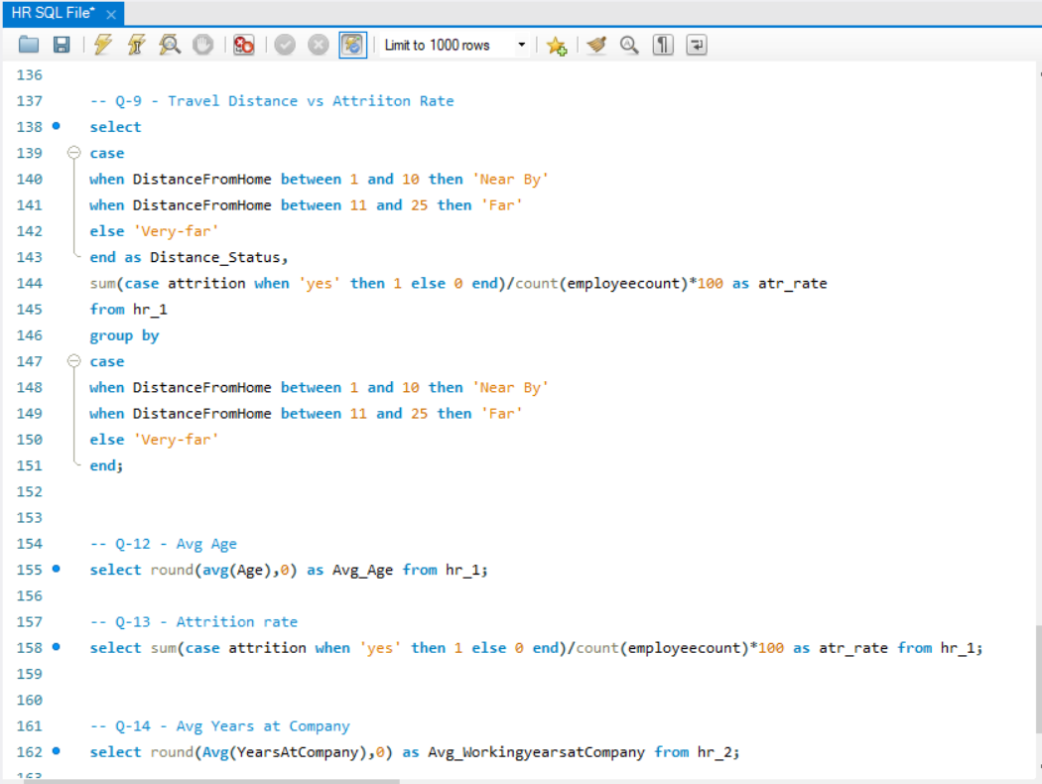
SQL Queries

Slide 23
KEY INSIGHTS
Out of 50000 Employees, 25105 Employees left the Organization recording the Attrition rate of 50.21%.
Department With Lower Average Monthly Income Has Highest Attrition Rate.
Highest Attrition Among Employee Aged Above 56 & Between 26 to 35.
Almost All Department Maintain The Similar Average Work Life Balance With Slight Difference.
Significant Attrition In The First Year.

Slide 24
Recommendations
Enhance Onboarding Processes.
Offer Career Development Opportunities.
Reevaluate Compensation Structures.
Investigate And Address Role-specific Issues.
Conduct Training For Career Growth Plans.

Slide 25
Conclusions
The Conclusion Of HR Analytics Project Is Not Just The End Of The Analysis Phase But The Beginning Of A Continuous Improvement Cycle.
By Regularly Monitoring Key Metrics And Refining Strategies, Organizations Can Maximize The Benefits Of Data-driven HR Practices.
Would You Like To Discuss A Specific HR Analytics Project Or Explore A Particular Aspect Of The Conclusion Phase In More Detail .

Slide 26
THANK YOU !!!

